Slide 1
Generative adversarial networks
Biplab Banerjee

Slide 2
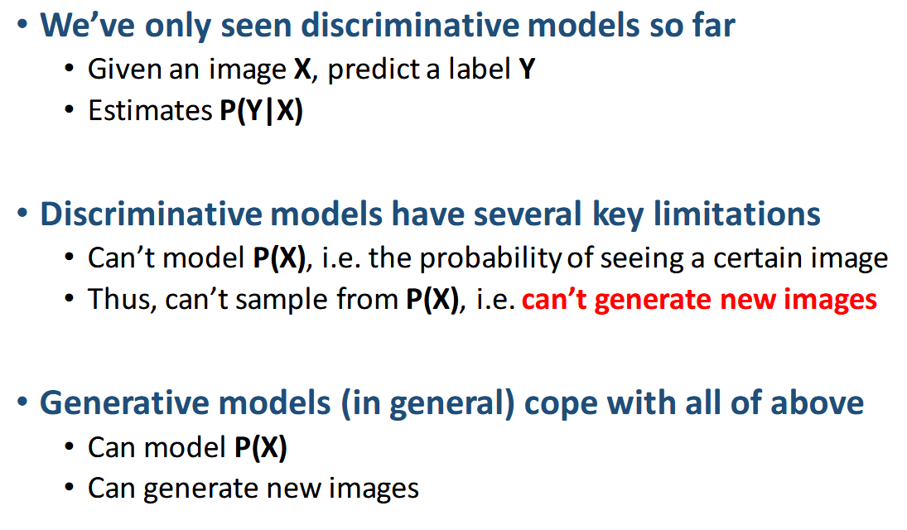

Slide 3
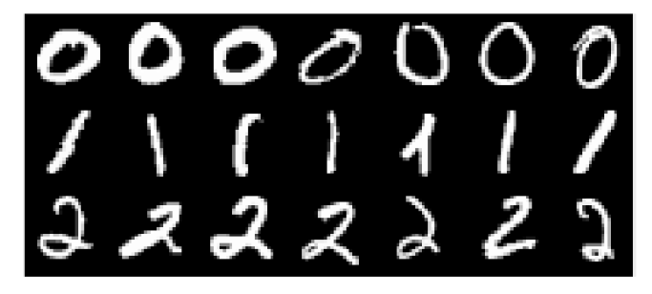
Implicit density estimation problem
What if we are only interested to sample from the complex high dimensional intractable data distribution without caring to know P(data) at all?

Slide 4
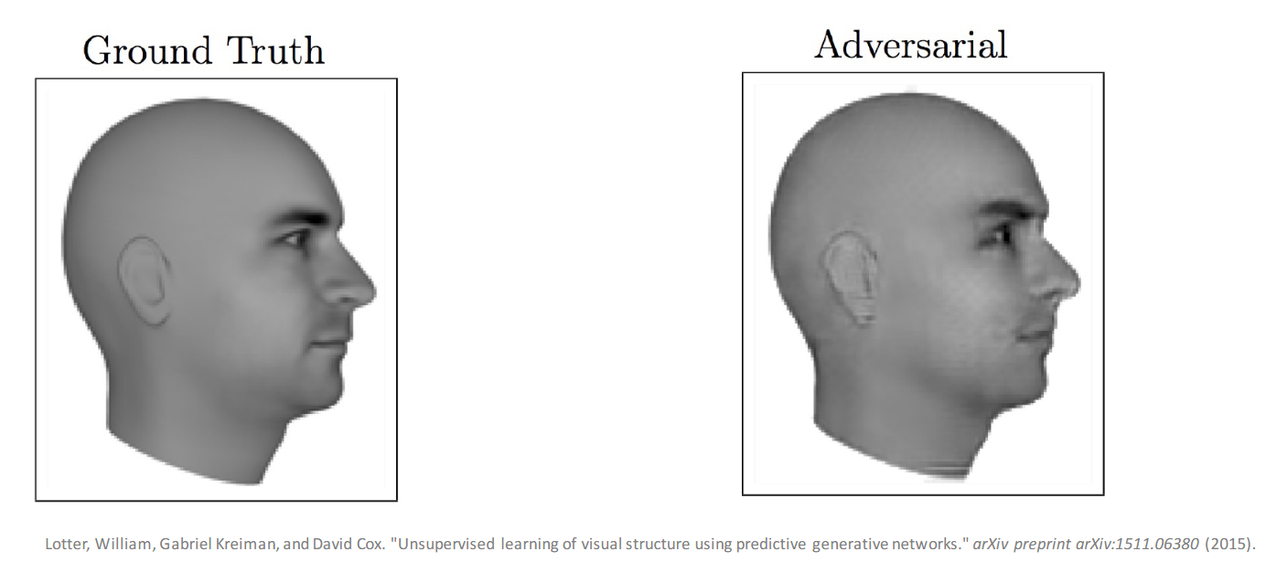
Magic of GAN

Slide 5
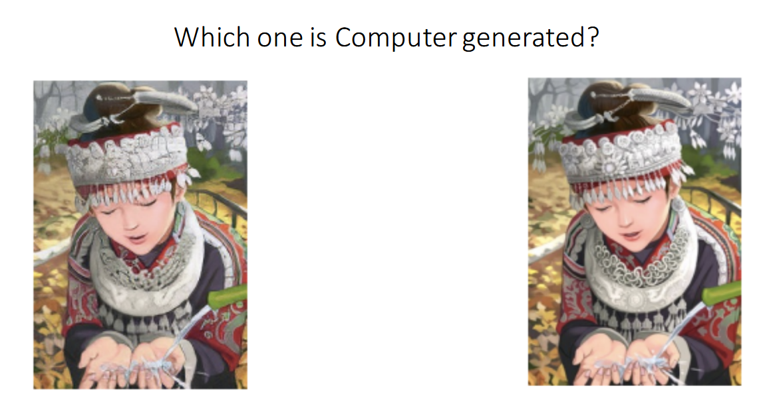
Magic of GAN

Slide 6
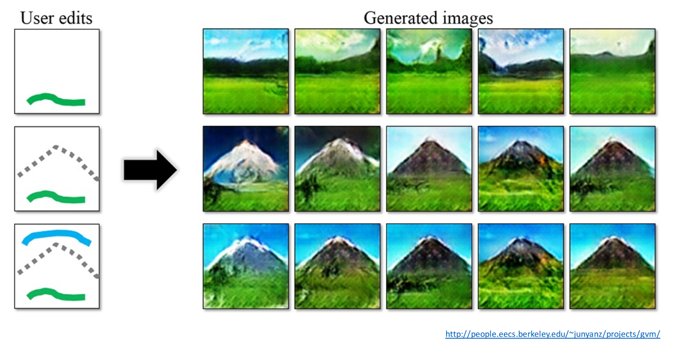

Slide 7
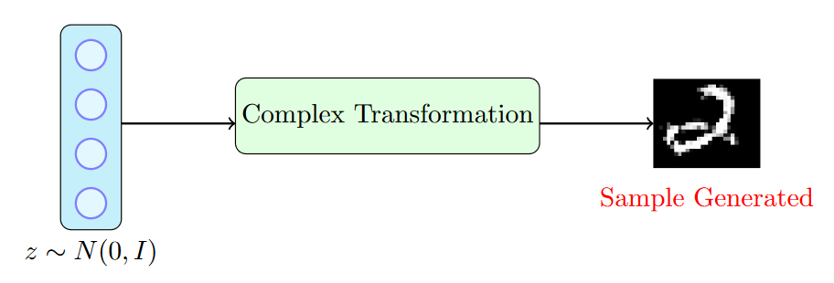
What about

Slide 8
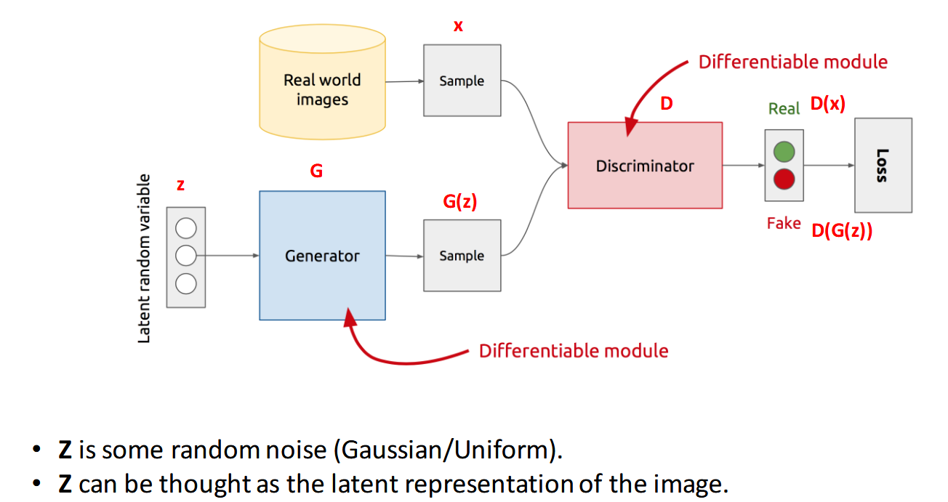

Slide 9
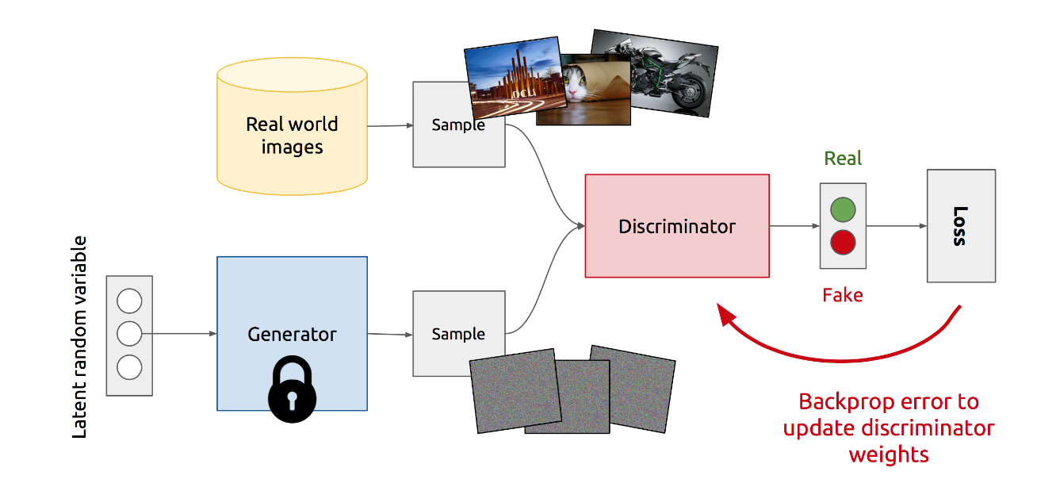
Training discriminator

Slide 10
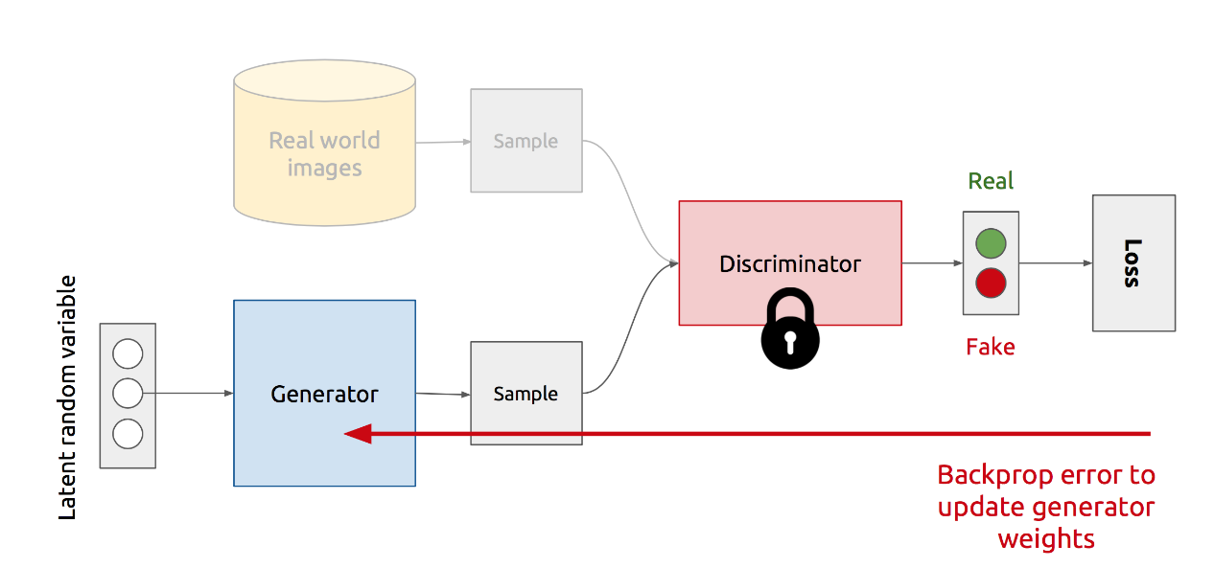
Training generator

Slide 11
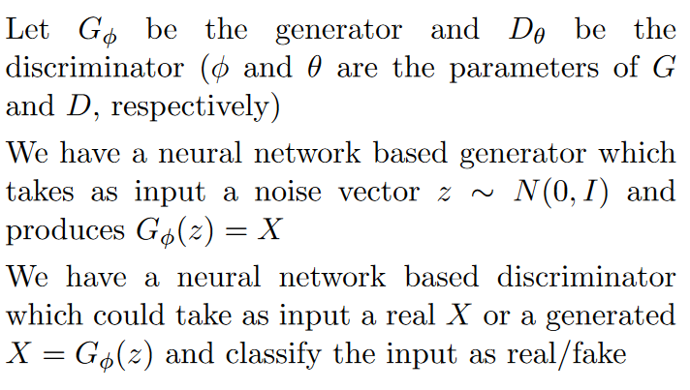
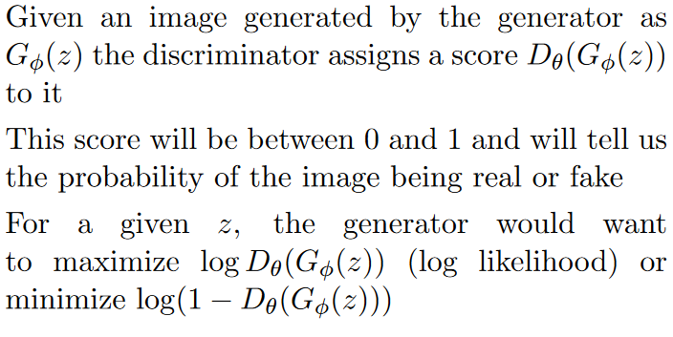
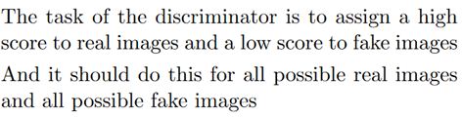

Slide 12
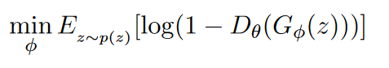
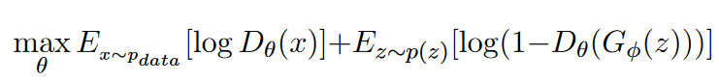
Loss functions
For generator
For discriminator

Slide 13
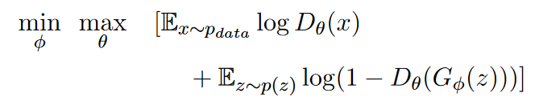
Loss function
Generator minimizes it
Discriminator maximizes it

Slide 14
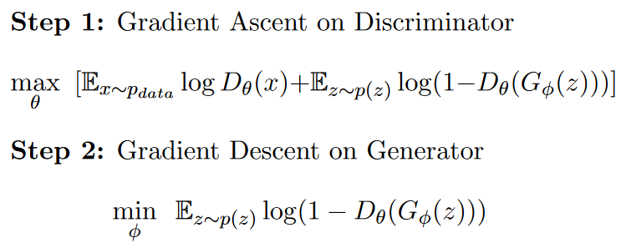
Training a vanilla GAN

Slide 15
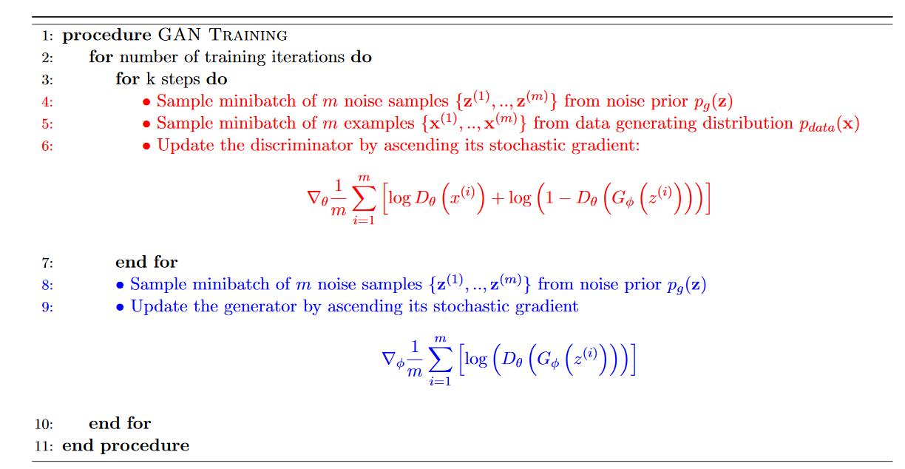

Slide 16
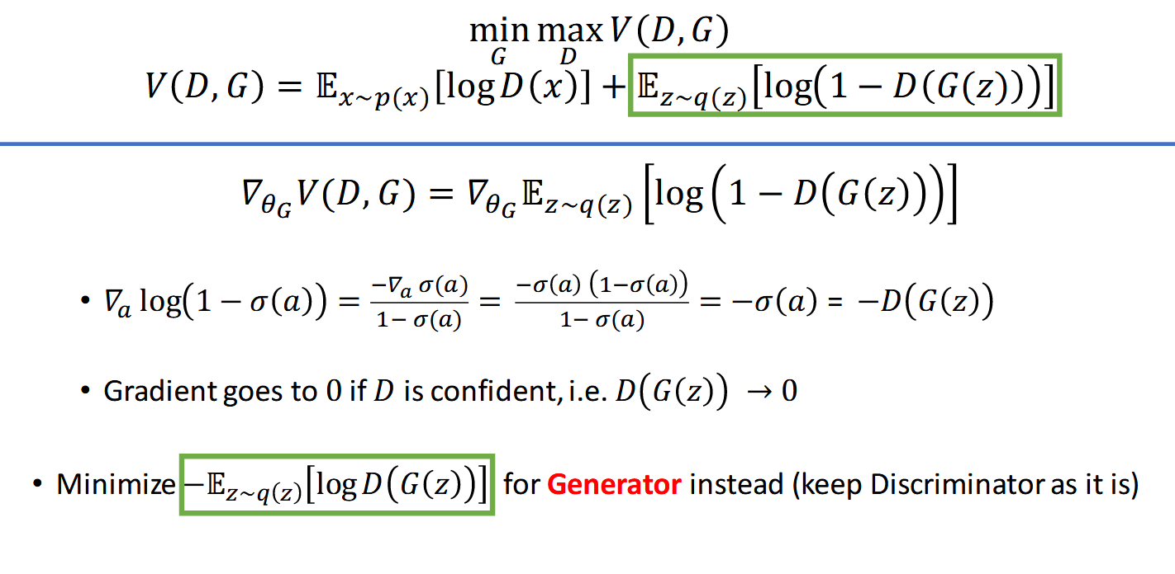
Tackling vanishing gradients

Slide 17
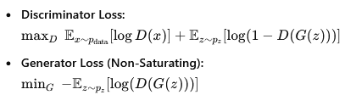
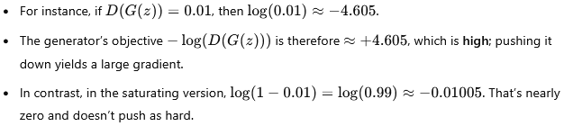

Slide 18
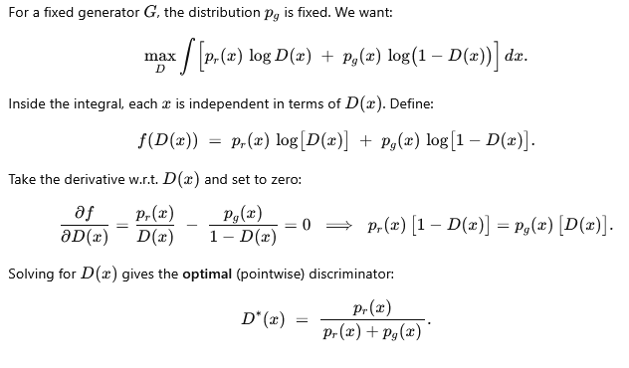
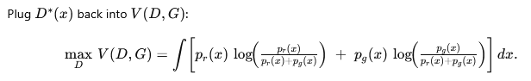
Optimal D

Slide 19
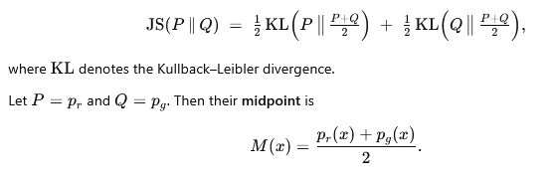
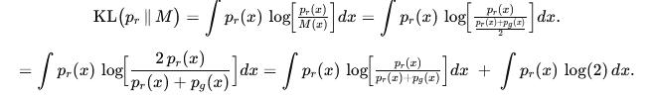
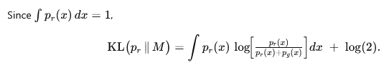
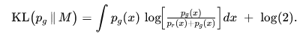
Global optima

Slide 20
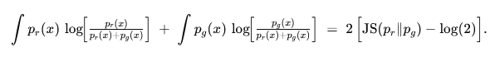
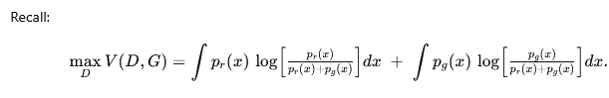
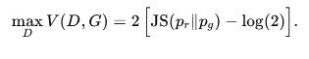
Global optima

Slide 21
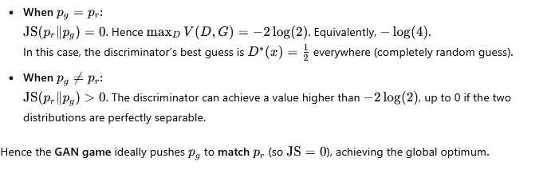
Interpretation

Slide 22
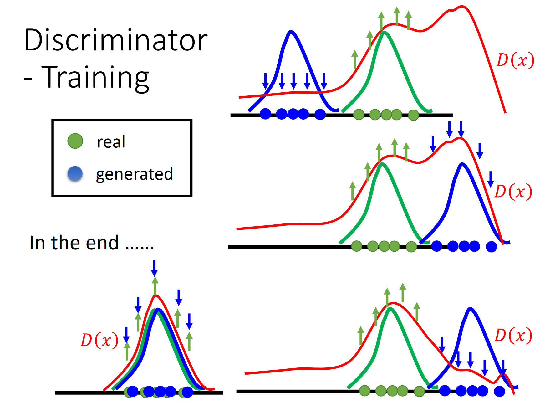

Slide 23
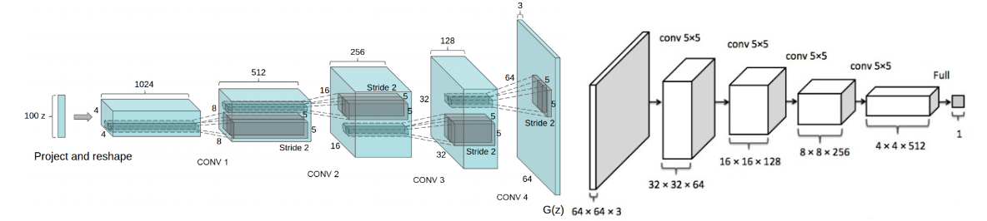
DC GAN

Slide 24
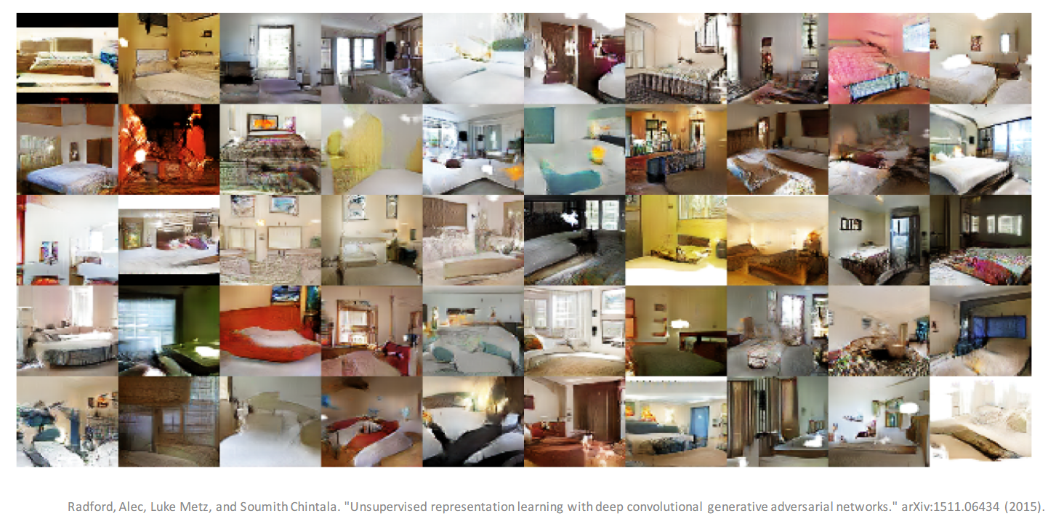

Slide 25
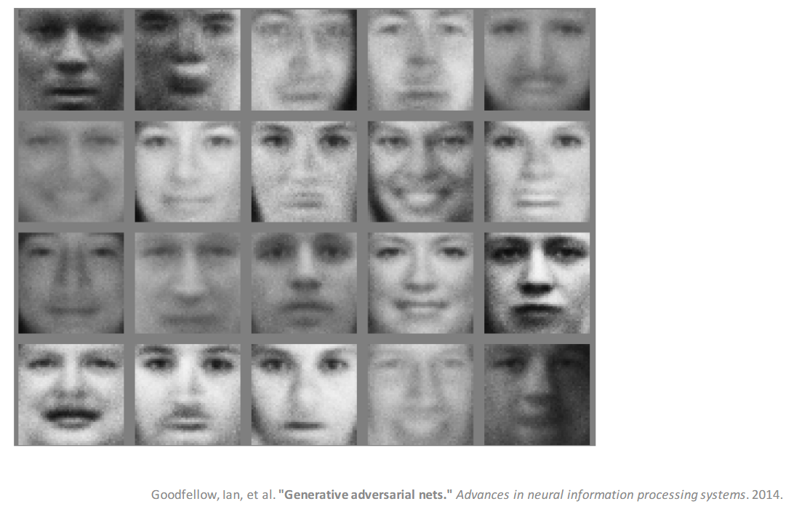

Slide 26
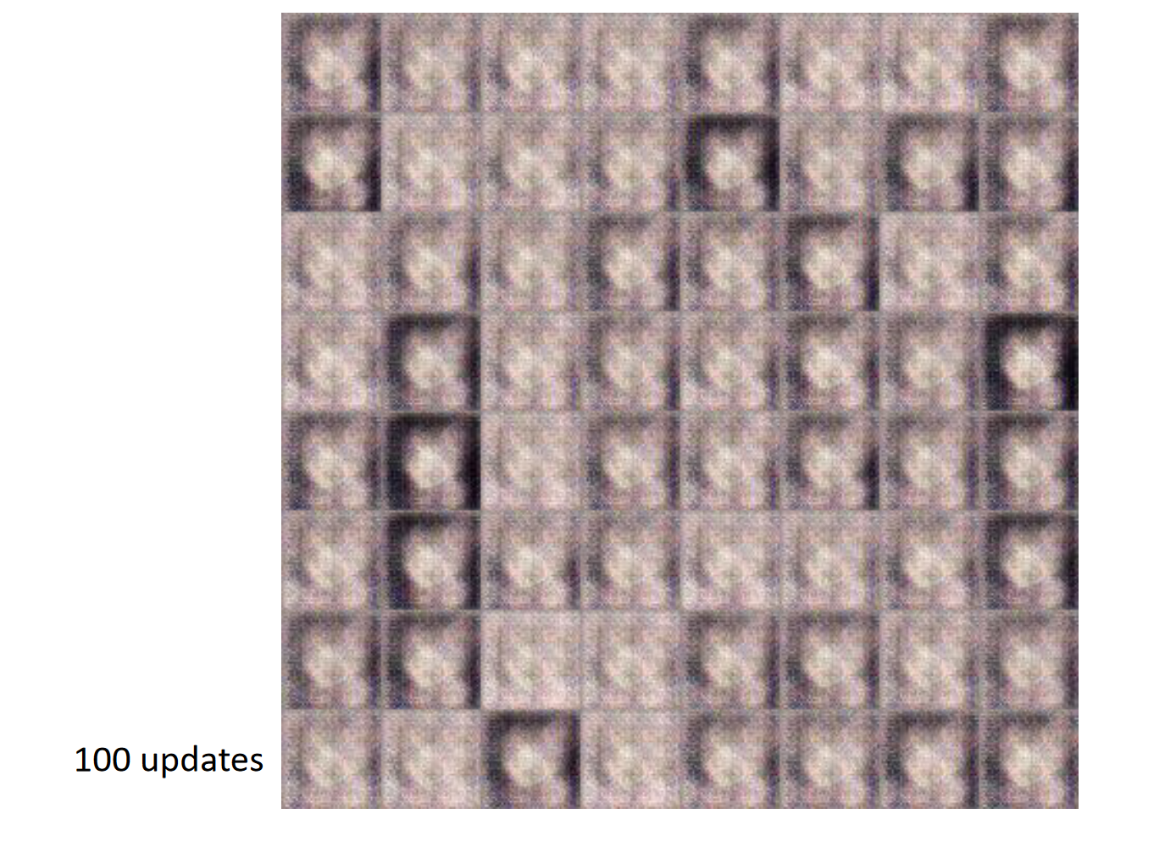

Slide 27
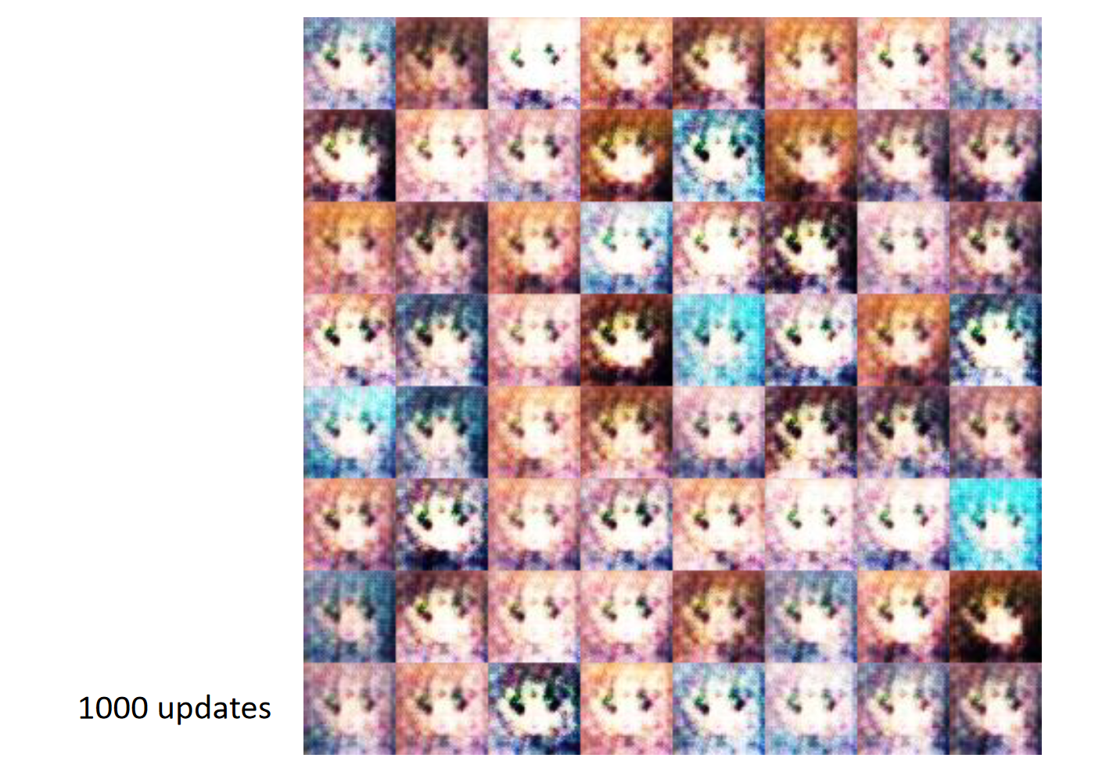

Slide 28
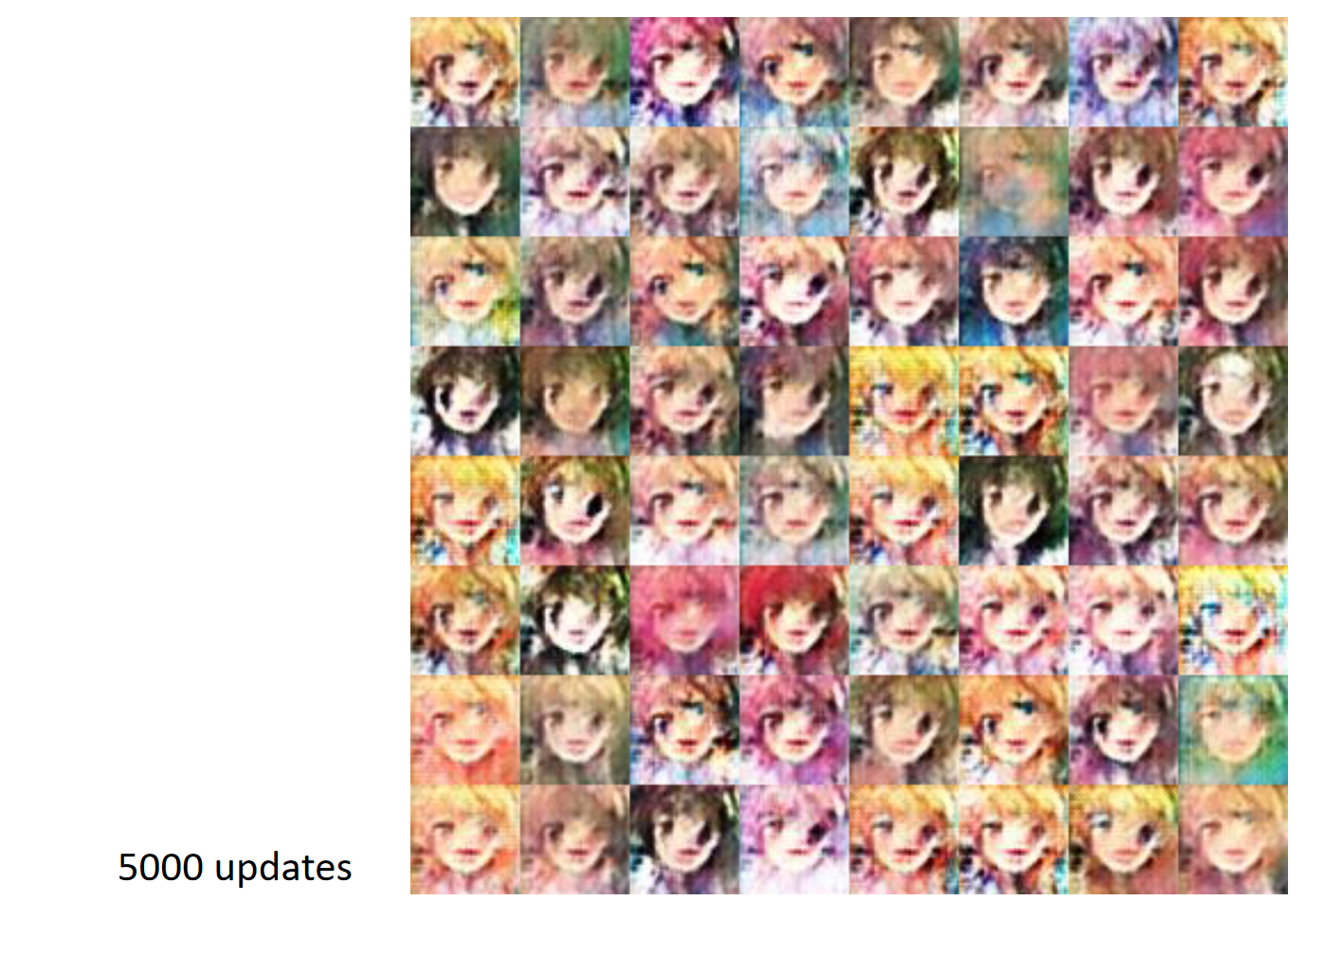

Slide 29
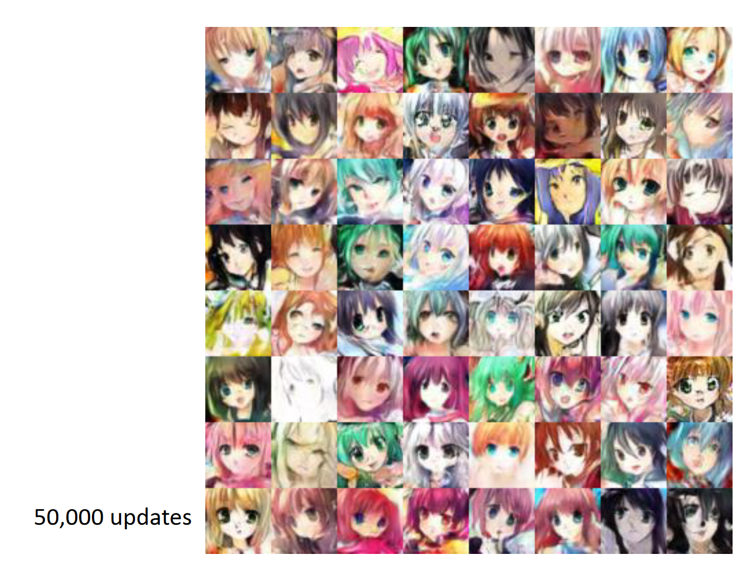

Slide 30
Some tips for GAN network design
Replace pooling by strided convolution and unpolling by fractional strided convolution
Use batch-norm
Avoid FC layers in deeper architectures
Use ReLU in all the generator layers except output where
use tanh
Use leaky-ReLU in the discriminator layers
** See GAN-hacks (by soumith chintala) for more details

Slide 31
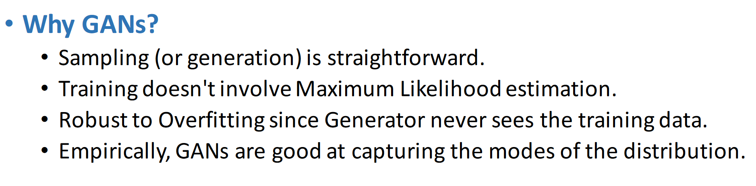

Slide 32
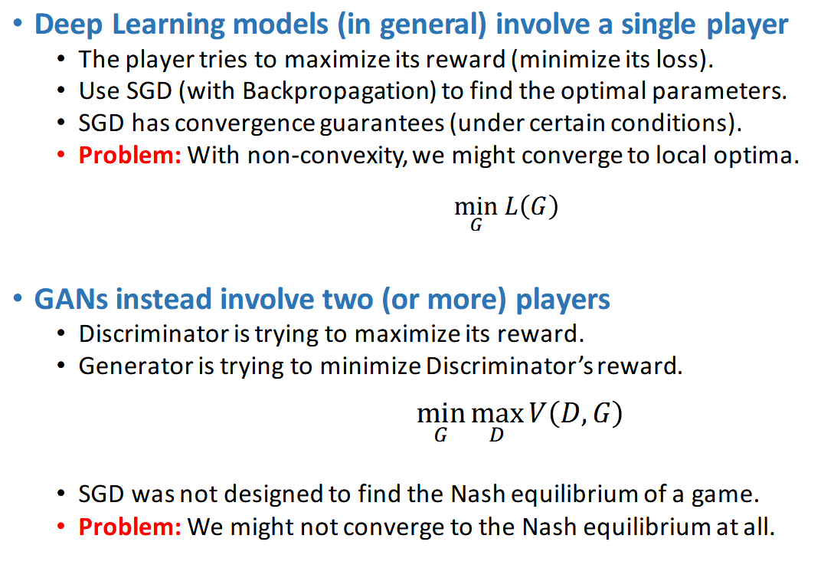
Non convergence of GAN training

Slide 33
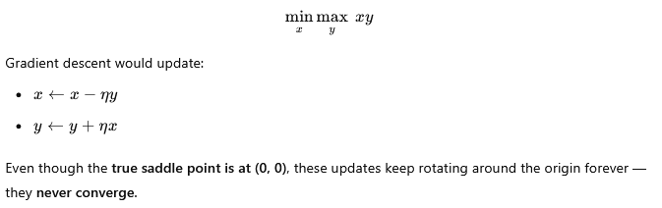
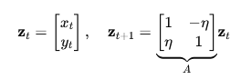
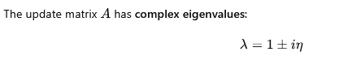
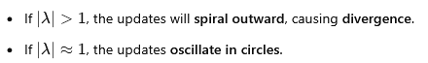
Lets consider an example

Slide 34
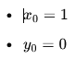
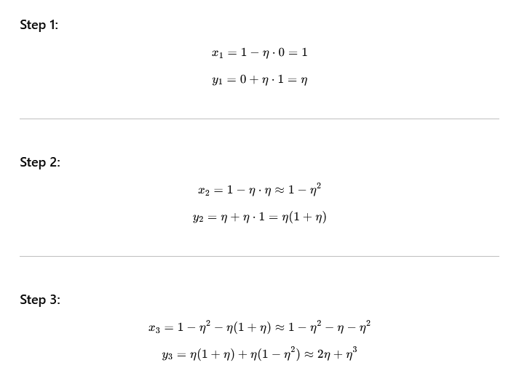

Slide 35
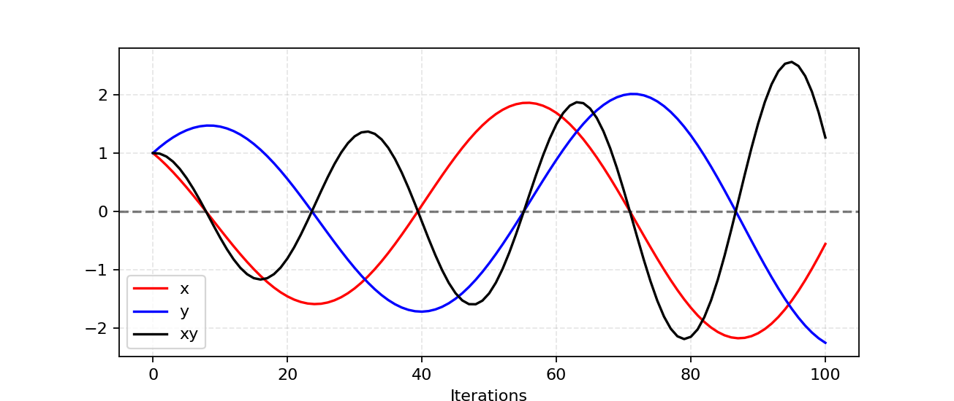
Problem in obtaining the equilibrium

Slide 36
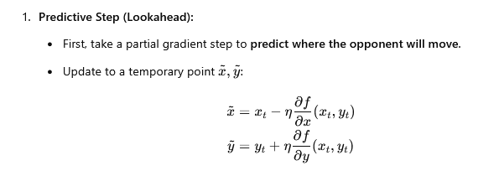
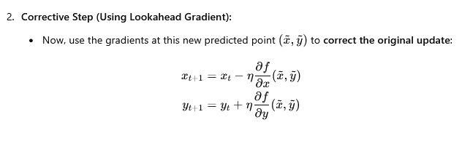
What are the solutions
Reduce learning rate
Use different learning rates for the generator and discriminator
Predict the next step’s gradient and use it to stabilize updates.

Slide 37
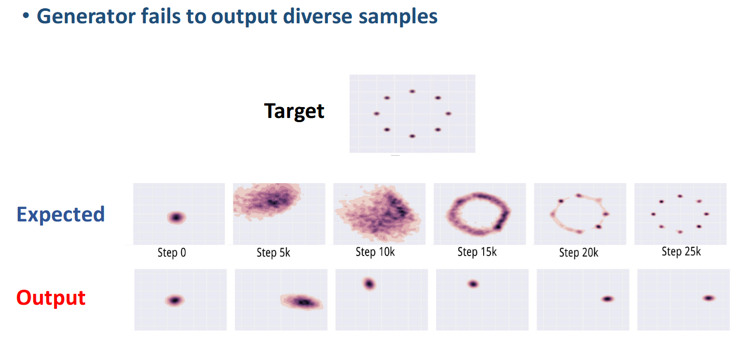
Mode collapse

Slide 38

Mode collapse in MNIST

Slide 39


Slide 40

Feature matching

Slide 41

Feature matching

Slide 42


Slide 43

Supervision with labels

Slide 44


Slide 45

One issue of vanilla GAN

Slide 46

Latent vectors capture meaningful information

Slide 47


Slide 48

Goal of InfoGAN
Learn a structured and disentangled latent space where each latent variable controls a distinct,
interpretable factor.
Encourage the generator to encode meaningful latent codes that correspond to different aspects of
the generated data.

Slide 49



InfoGAN

Slide 50


Idea of mutual information

Slide 51

Calculating MI directly is difficult

Slide 52


Slide 53

An alternate view of GAN

Slide 54



Slide 55



Least-Square GAN

Slide 56


Qualitative results

Slide 57


Calculate KL, JS

Slide 58



Slide 59

EM distance

Slide 60


Slide 61

Wasserstein distance

Slide 62

In discrete space

Slide 63


Kantorvich-Rubinson dualty

Slide 64

The WGAN loss

Slide 65


Slide 66


Slide 67


Slide 68


Slide 69

Problem with clipping parameter

Slide 70


W-GAN GP

Slide 71
Why we do not apply the regularizr on real or fake points
The optimal critic in WGAN tends to have linear behavior between real and fake
So the region between real and fake samples is where:
The gradient might violate the Lipschitz constraint.
The critic function is expected to change the most.

Slide 72


Slide 73

WGAN GP experiments

Slide 74


Slide 75

CGAN – using the labels

Slide 76

InfoGAN – labels as latent variables

